Slide 1
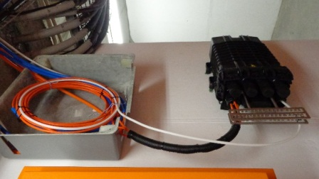
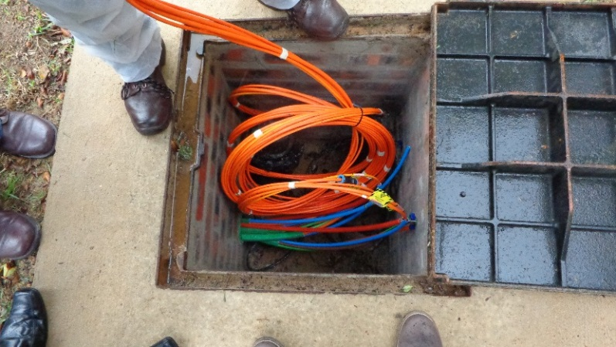
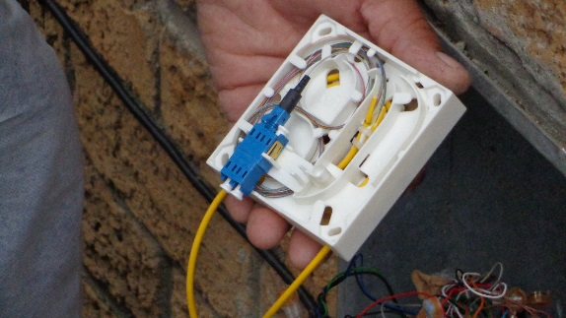
Telkom’s “Open Access” Fibre to the Home Network (FTTH)

Slide 2
Legal Notice
This document, and the attachment/s thereto are intended strictly for the addressee(s), and should only be used for the purposes originally intended for. Any use of this document, or its attachments, by any one, and for any purpose other than for its original intent, is a violation of the confidentiality agreement stipulated by this statement. In such a case, Telkom reserves the right to claim direct, indirect, special or consequential damages, including, and without limitation, any loss of profits, loss of revenue, loss of income, business interruption, loss of programs or data to the value as determined by Telkom. Telkom shall also not be liable to any third party for damages of whatever nature suffered, as a result of the usage of this document for any purpose or reason other than that intended for.

Slide 3
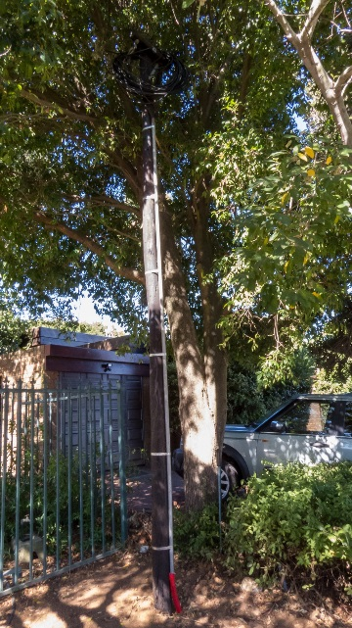
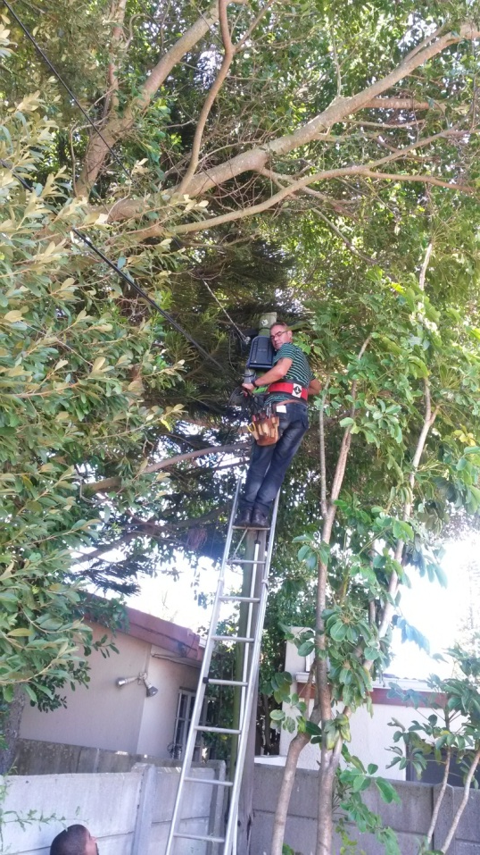
What is . . .
What is Fibre To The Home (FTTH)?
What is an Open Access Network?
What is required in the home?
What is the cost of a FTTH network?

Slide 4
What is . . .
Fibre To The Home (FTTH)?
Fibre all the way, from the Telkom Exchange in your suburb, right into your house (and not just to the doorstep!)
Making download speeds of up to 100Mbits/sec possible, 5 times faster than the fastest DSL. Giving you a truly “connected” home – mails. movies in HD, gaming and superfast surfing of the internet- whatever you desire
Replaces your copper connection, and is less susceptible to interference and the environment, offering a more reliable and stable service, and a less attractive target for theft.
1
An Open Access Network?
Telkom provides the end to end fibre network.
Telkom has relationships with most of the major ISP’s in South Africa and offers this connectivity on a re-sell principle.
You choose your Internet Service Provider and the package that best suits you. You only deal with your chosen Service Provider and only get one bill.
Telkom Retail is just one of the Service Providers you can choose from.
2
Required in the home?
Telkom will install an Optical Network Termination (ONT) unit in your home. This is the size of a DSL modem and you need to provide an AC power point,
We need to connect the ONT to our fibre network via a “drop” fibre cable. If your area has an underground distribution network you will need to provide a duct from the boundary to your house, otherwise Telkom will “drop” a cable from the closest pole.
You or your service provider must connect a suitable modem to the ONT. This will provide the broadband connectivity in your home.
3
The cost of a FTTH network?
With the exception of providing ducts on private property, Telkom carries all the investment cost and associated risk. Telkom will provide the network from the closest exchange right into you house.
Where homes are fed via underground cable the customer is required to provide a duct between the property boundary and a suitable entry point into the house. In gated communities Telkom will enter into an agreement with the representative body (e.g. Home Owners Association/Body Corporate or Developer ) regarding cost sharing for the duct network within the complex . Telkom is fully responsible for cabling costs.
4

Slide 5
Understanding the Technical Terms
The Cable Network
Redundancy
The GPON Technology
Quality of Service (QoS)
Overhead
Drop Wire
Local Exchange
Underground
Feeder Cable
Splitter
Distribution
Fibre
DP
OLT
Underground Cable
Distribution Point
Pole or Manhole
MSAN
Manhole

Slide 6
Understanding the Technical Terms
The Cable Network
Telkom has 1900 central offices ( local exchanges) in South Africa. If you live in a metro area, chances are that you are close to a local office.
Optic Fibre “Feeder” cables are deployed in an underground duct network from the local office to a splitter.
A “Distribution” optic fibre cable connects the splitter to a distribution point. This distribution point serves a small cluster of houses and may be situated either underground or mounted on a pole.
A “Drop” cable connects a house to a distribution point.
1
The GPON Technology (Gigabit Passive Optical Network)
Telkom offers an asymmetrical GPON service (download speed is higher than upload speed)
Since 2012 Telkom has been progressively migrating all its consumer services to an integrated new generation network, with a single platform carrying different types of traffic.
Telkom does not have a stand alone GPON network, but provides this service off “state of the art” Huawei MA5600/Alcatel Lucent 7320 ISAM multiservice platforms. Telkom has strategic partnership relationships with both of these multinational equipment vendors and stays current with their technology upgrades.
2
Quality of Service (QoS)
Telkom provides the Open Access FTTH service on a best effort principle and does not offer guarantees on uptime and SLA’s on repairs.
Telkom has a world class National Network Operating Centre which continually monitors all network elements. All network incidents from the central office back into the network are attended to on a 24/7 basis.
Faults in the feeder, distribution and drop networks are attended to during business hours.
In the first instance you should contact your ISP, who will determine where the fault lies. They will hand over to Telkom if necessary.
3
Redundancy
Telkom does not provide redundancy (alternate routing in case of failure) in the FTTH network between the central office and your ONT.
Between Telkom’s Central Office and the connection point to the ISP, Telkom’s network is engineered to offer a high level of redundancy. With multiple paths connecting central offices to its regional Metro Ethernet networks, and multiple paths from regional nodes to its NG SDH national network, Telkom offers the highest level of redundancy achievable.
Between Telkom’s network and the chosen ISP, the redundancy is dependent on the ISP.
4

Slide 7
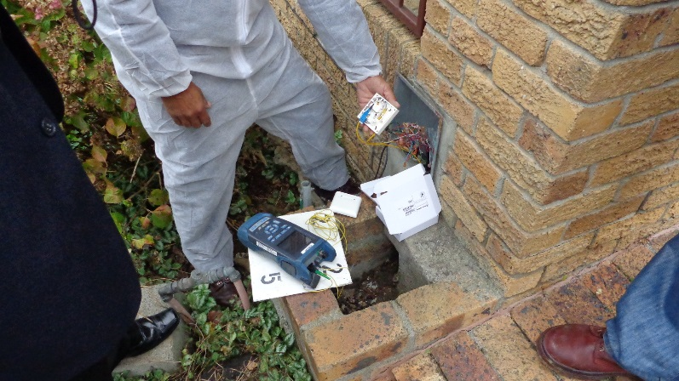
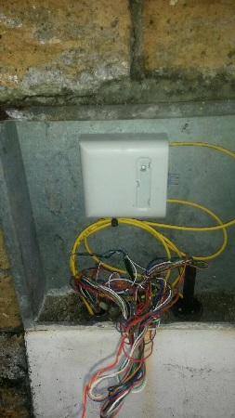
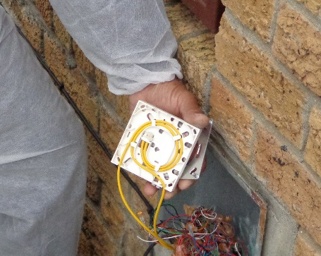
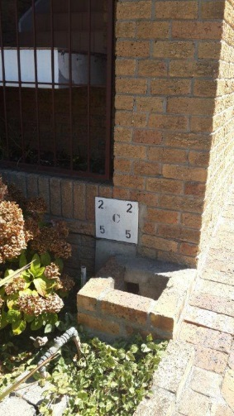
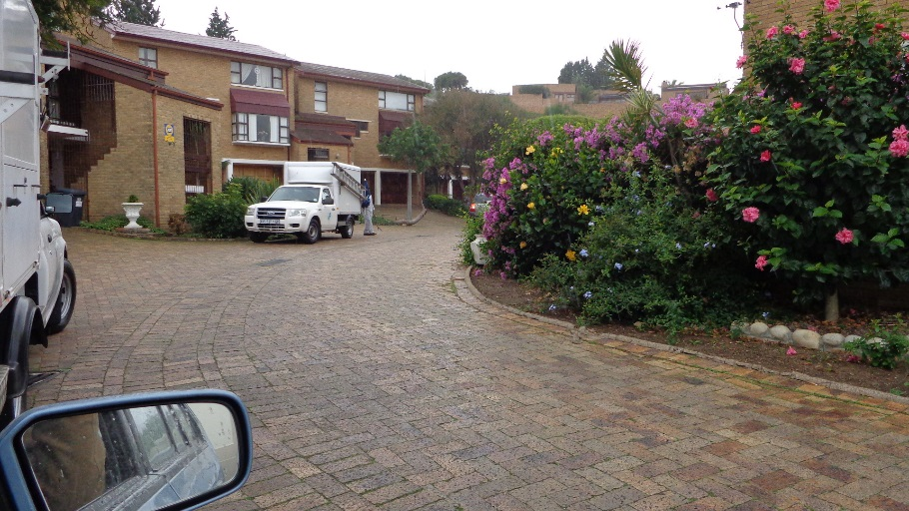
Some practical matters
How long will it take to bring fibre to my area?
What impact will the construction have on my area?
How is my service installed?

Slide 8
Some practical matters
How long will it take to bring fibre to my area?
After a decision is taken to invest in an area, then on average:-
Two months for the detailed surveys and engineering.
One month to obtain the necessary permits and approvals from the local authorities (for trenching operations).
Three to six months for the physical build work and hauling of cable. This time is obviously very much dependent upon:-
The size of the project.
The ease with which we can gain access to properties – we often need to get into your neighbour’s backyard.; The area itself –”old” established areas with larger plots and plenty of trees (roots not friendly to underground pipes and branches hostile to overhead routes) take somewhat longer than newly developed areas.
1
What impact will the construction have on my area?
While Telkom will do everything possible to minimize the disruption to your neighbourhood, we will probably need to dig. Trenching will happen mainly on the sidewalks and maybe across your driveway.
You will receive advance notification of the work to be performed.
We may also need to hang aerial cable on the pole route running past your backyard, and once its up we may need to send in a technician to splice the fibre.
3
How is my service installed?
After placing your order with your ISP, Telkom will contact you to make an appointment for a technician to do the installation.
If you live in an area with underground distribution please ensure that existing pipes can accommodate a drop fibre cable (diameter) or that there is a new duct laid from your boundary wall to inside your house.
The location you choose for your ONT should be close to an AC power outlet and close to the pipe entry point.
The Telkom technician will connect your home via a drop fibre terminated on the ONT.
4

Slide 9
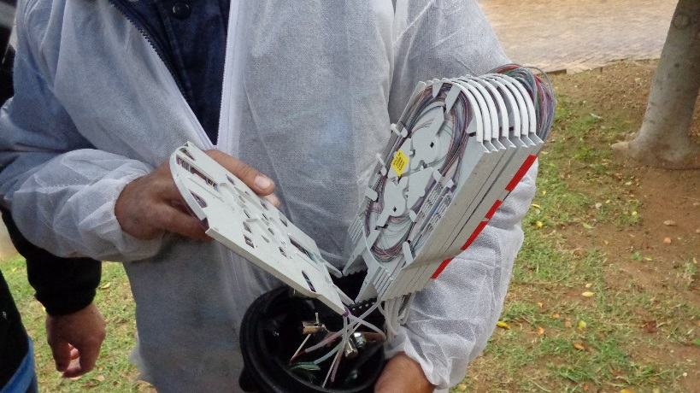
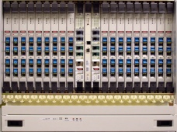
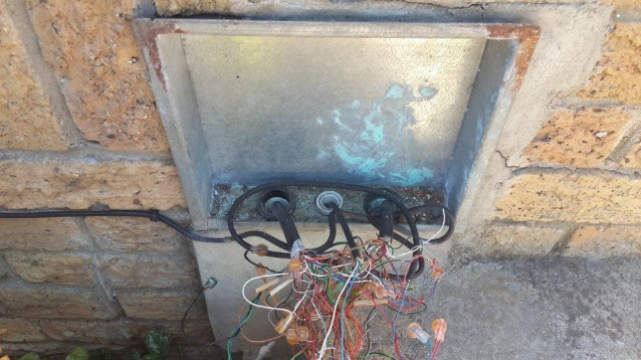
Some frequently asked questions
What about CCTV, smart metering etc.
Another Operator has indicated that they will fibre my area?
I live in the area and don’t want a fibre connection
Why can’t you sell me a Telkom service?

Slide 10
Some frequently asked questions
What about CCTV, smart metering etc.
Telkom is providing an open access FTTH network in your suburb. For Value Added services you should approach an appropriate service provider who can provide these specialist services over the FTTH network.
1
Another Operator has indicated that they will fibre my area?
In terms of the Electronic Communications Act, every licensed operator has the right to build telecommunications networks on public and private land – licensed operators can choose where they build.
Telkom has existing networks in most suburbs across the country. Just as rolling out FTTC (Fibre to the Curb) to some suburbs was a natural evolution of our network to provide better service, investment of FTTH is a natural path to enhancing our service offering to our existing customer base.
2
I live in the area and don’t want a fibre connection
If you have an existing copper based Telkom service you will not be immediately obliged to take a fibre based alternative.
Bear in mind that Telkom is making this major investment in your area not only to provide higher speed broadband, but also to improve the quality of service in your area. Not moving to fibre may mean that you are missing out.
3
Why can’t you sell me a Telkom service?
Telkom’s Wholesale and Networks organisation a business unit separate from Telkom Retail.
Telkom’s Wholesale and Networks supplies connectivity and services to all the major licensed operators and Internet Service Providers. Telkom Retail is just one of its customers.
In terms of the Competitions Act, and a Competitions Tribunal ruling, Telkom’s Wholesale and Networks organisation cannot favour Telkom Retail above its other customers. For this reason, Telkom’s Wholesale and Networks organisation does not promote Telkom Retail products and services.
4

Slide 11
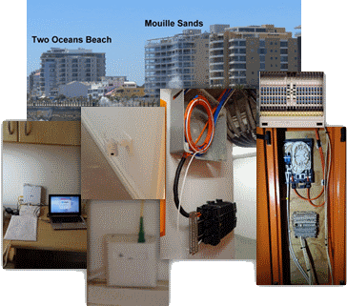
Why Telkom ?
We have the most extensive fibre network.
Telkom is the leader in Fibre Technology and FTTH
One Network
Easier installation for you
Field Support

Slide 12
Why Telkom ?
We have the most extensive fibre network
If you are in an established area in a city or town, there is a good chance that your area is already covered by an existing Telkom copper cable network.
We make use of our existing ducts, pole routes and rights of way, leading to less construction work and less disruption.
1
Telkom is the leader in Fibre Technology and FTTH
Telkom has been installing optic fibre since 1985, and has over 140 000 route km of fibre in its network.
By March 2015 Telkom’s FTTH network had already “passed” 31 000 homes .
2
One Network
From your home right up to the point where we connect to your ISP, your data is carried on one network, Telkom’s network.
We don’t rely on other operator’s networks to carry our traffic from suburb to regional node and then to connect to the web – we offer a seamless connection.
3
Easier installation for you
Our FTTH does not bring fibre to your doorstep, it brings the fibre right into your house. While other operators may stop at your boundary, we bring the fibre and ONT right into your home.
All we require is that you provide a pipe from your boundary wall to the house.
If you don’t want the hassle of arranging for the installation of this duct, we can do it for you at a competitive cost.
If you are already one of our 2.7 million customers, chances are that we can use the existing entry channels into your house.
4
Field Support
Telkom has a large force of experienced field technicians, backed up by a network of service providers, who provide installation and assurance services.
5

Slide 13
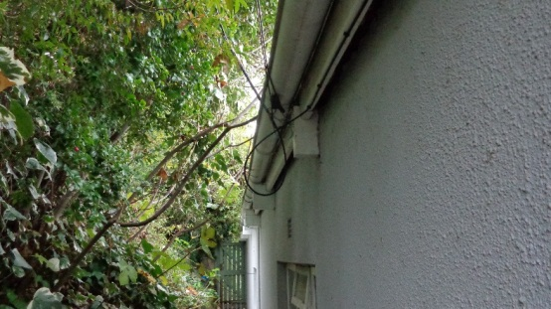
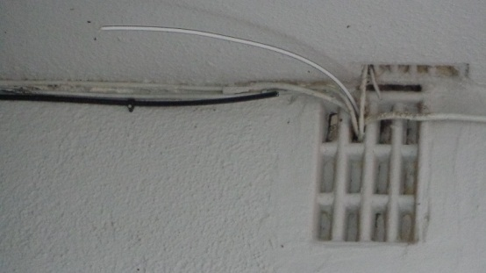
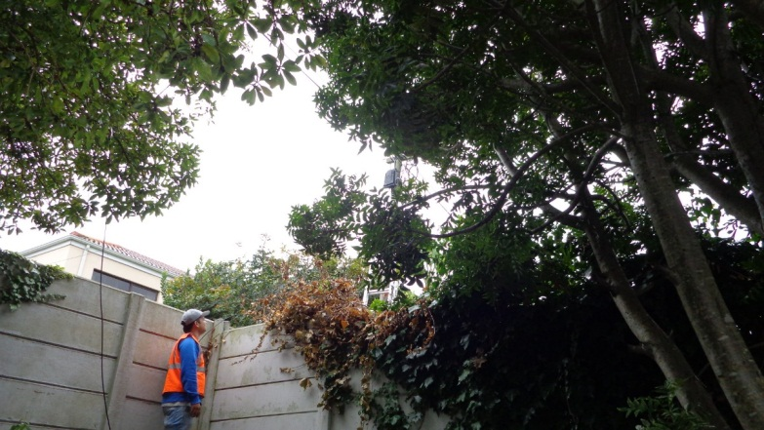
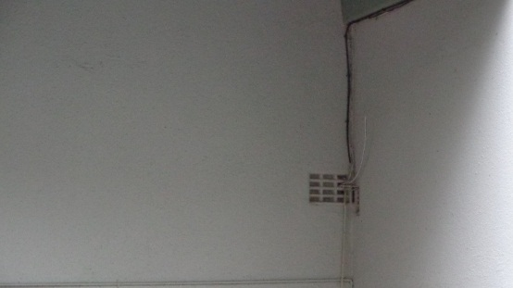
Get in touch with Telkom SA
/
If you are interested in a FTTH connection to your home, you can register on https://openserve.co.za/interest-register
For details on products, packages and services, please contact the Internet Service Provider of your choice. The following Internet Service Providers currently offer broadband services over Telkom’s FTTH network.
Mweb Connect
AfriHost Pty Ltd
WebAfrica
CyberSmart
Vox Telecom Ltd
Sainet Internet
Nexus Online
Mia Telecoms
Ispace Ltd
Iconnect
Goldtel Industries
Global Network Serv.
About IT online
Telkom Internet

